Slide 1
FitBook
A collaboration between Anthea Merton and Marcus Mellor

Slide 2
So what is it supposed to do ?
FitBook allows a person to record the food they eat, the exercise they take and from that understand whether they are on a path to continual growth, waist size that is, stay as they are, or lose a few of those pesky pounts.
It uses natural language processing, provided by Nutritionix, to break down the meal and exercise into elements, assigning a calory count against each.
It understands what your Basel Metabolic Rate is …. The calories you burn by just being alive. It calculates this from your weight, height and age. The calculation is different for men and women.

Slide 3
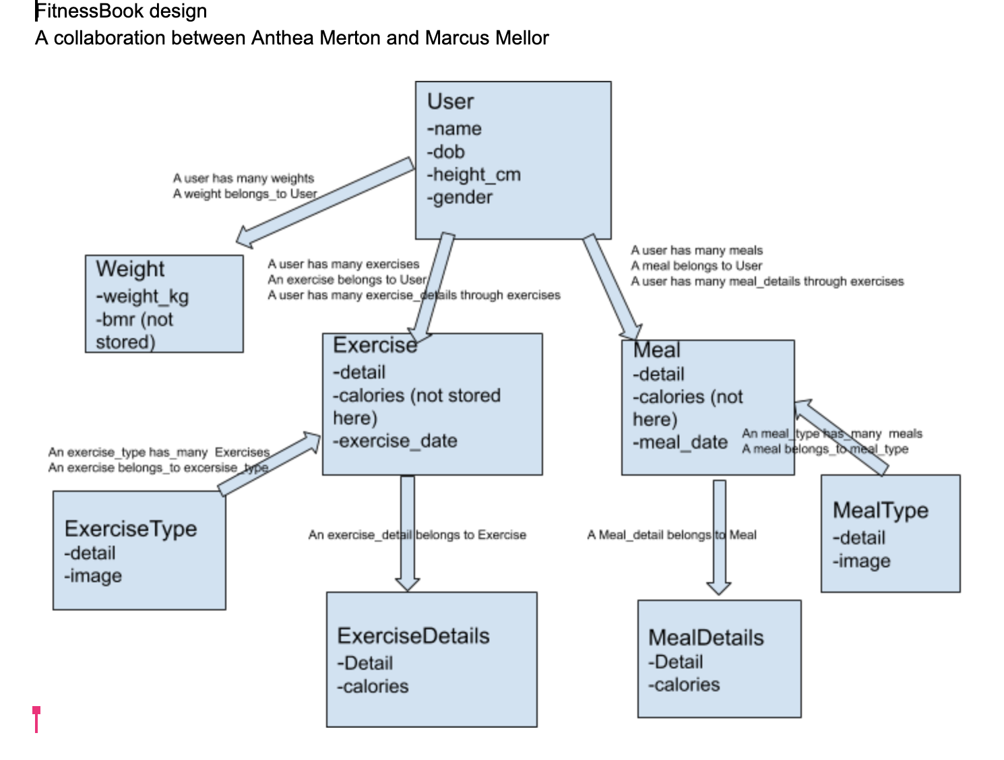
How complex is this then ?

Slide 4
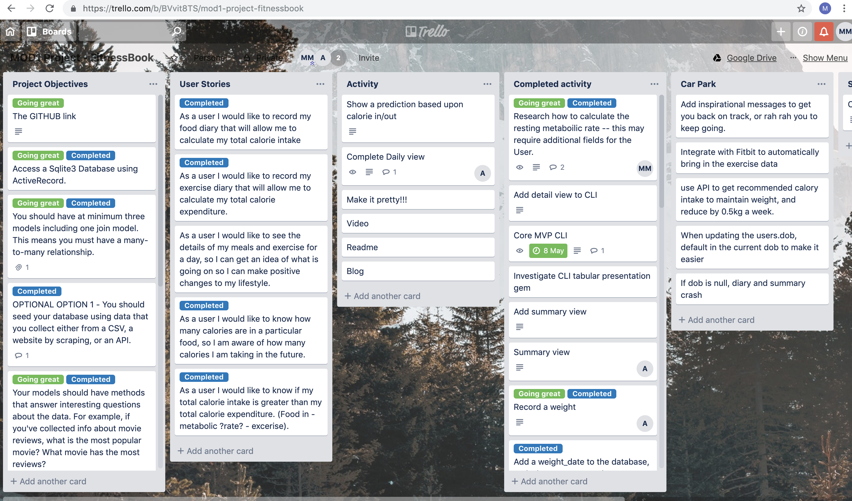
And how did we collaborate ?
We used
Trello

Slide 5
What was hard ?
Use of dates
Arrays getting in the way of object methods
Git merging
Putting it all together
Understanding the error messages

Slide 6
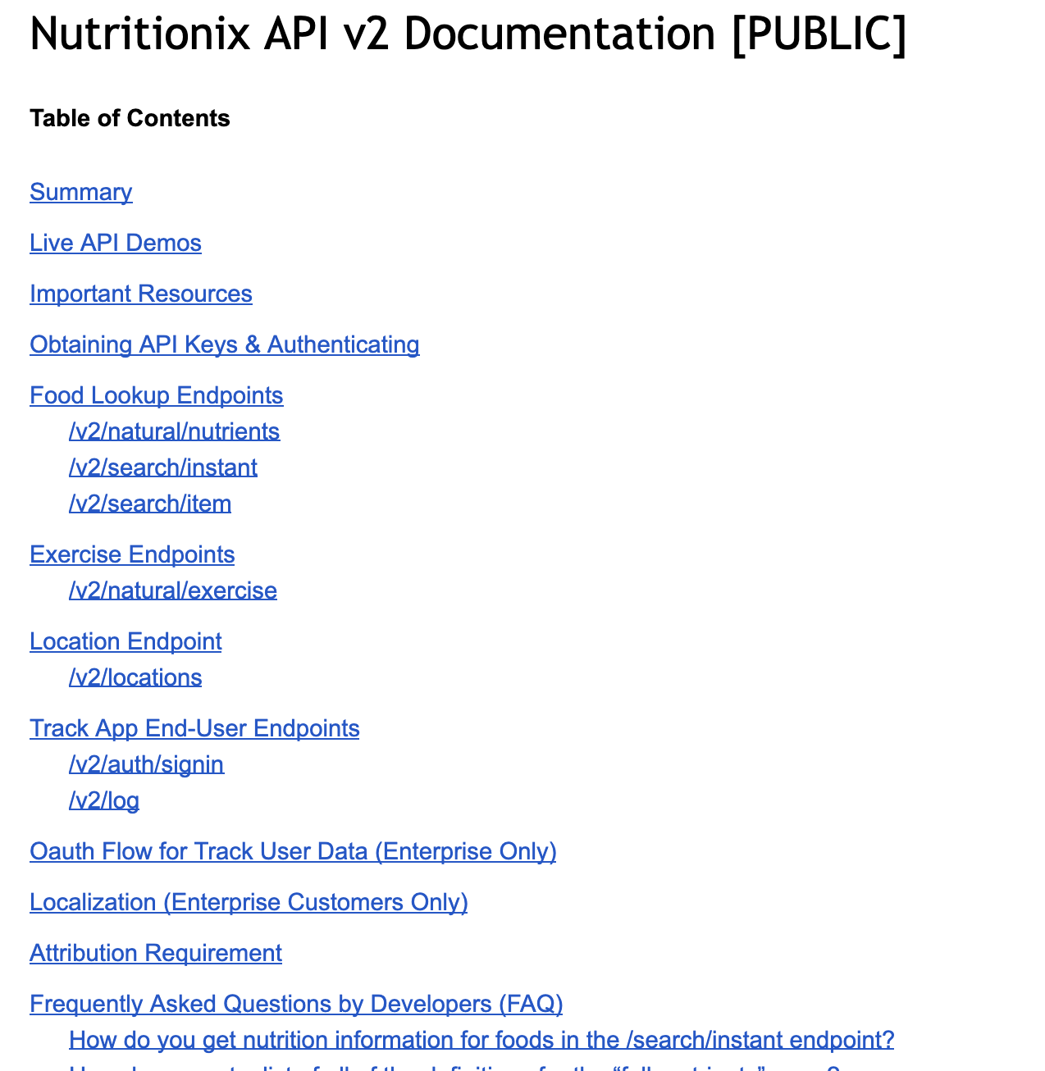
What was surprisingly easy ?
The Nutrionix API
Active Record
Git when it worked
The display gems

Slide 7
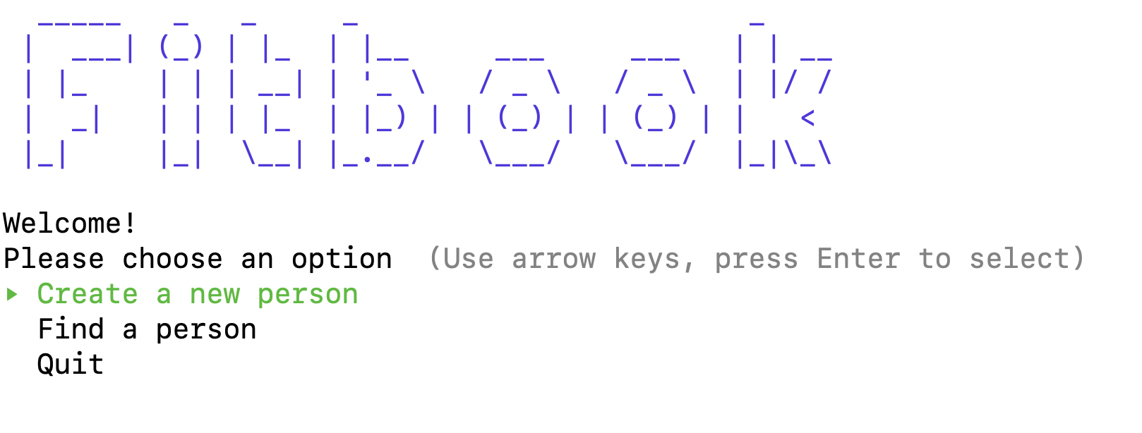


Slide 8
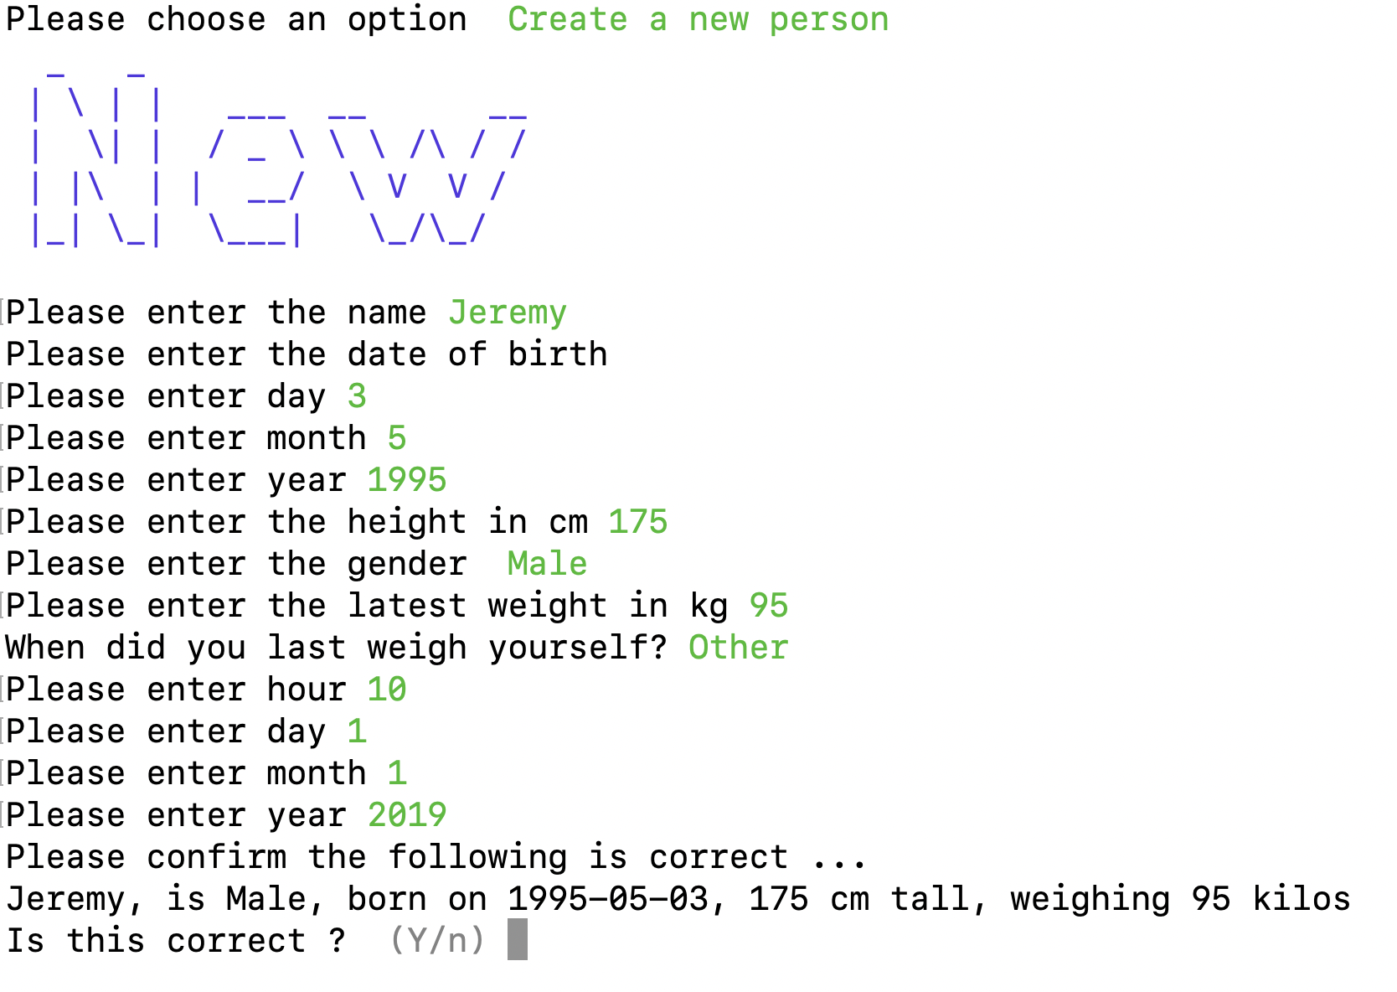

Slide 9
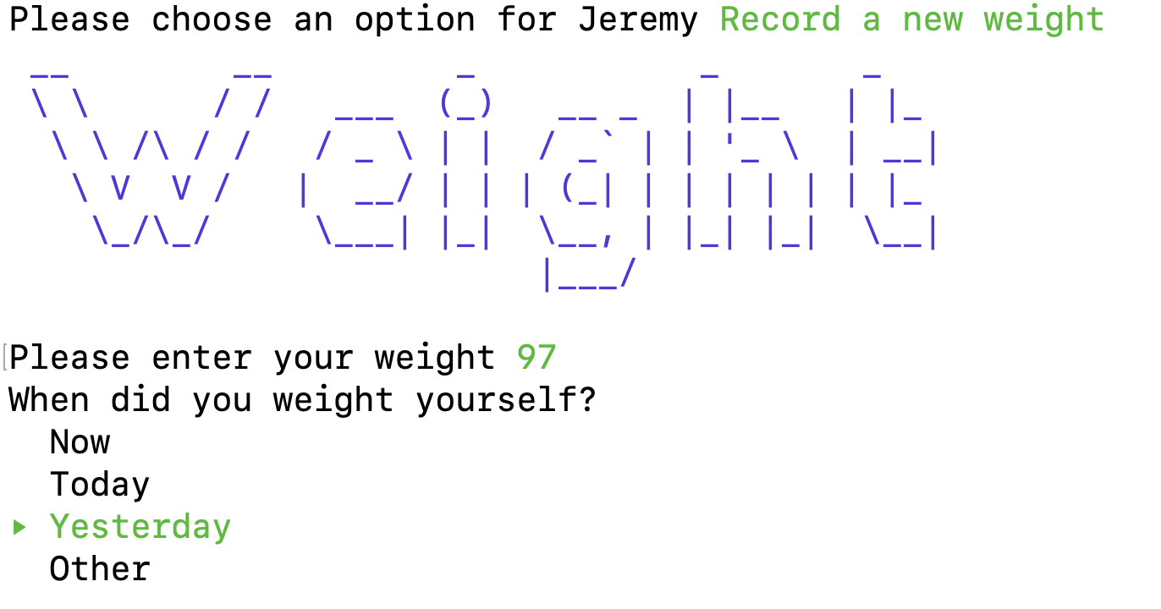

Slide 10
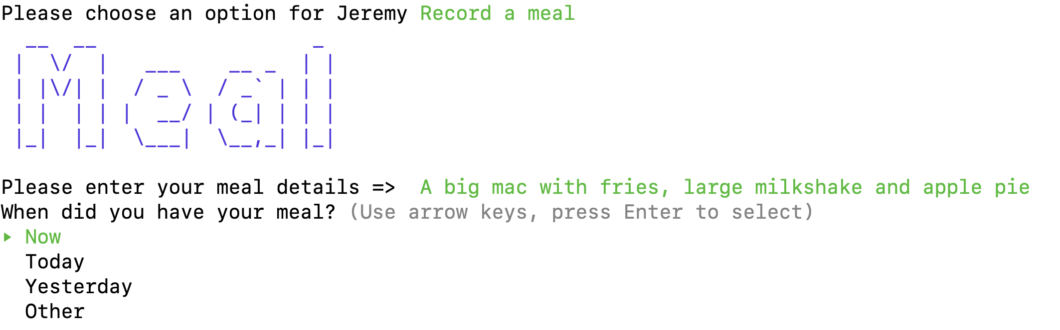

Slide 11
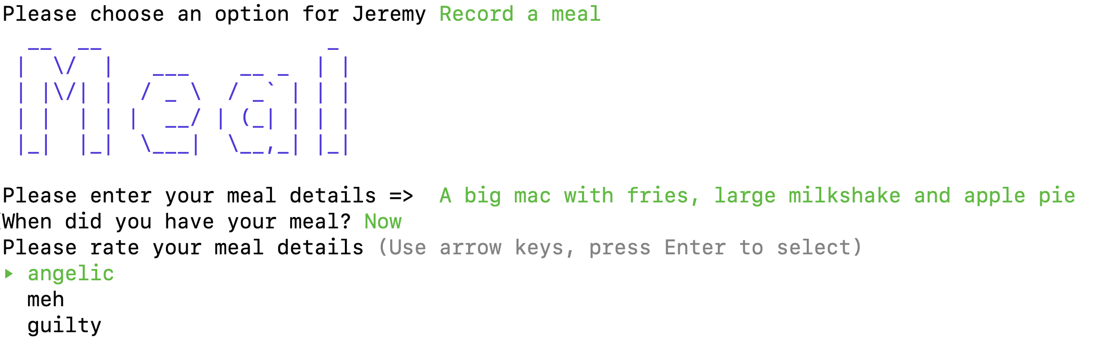

Slide 12
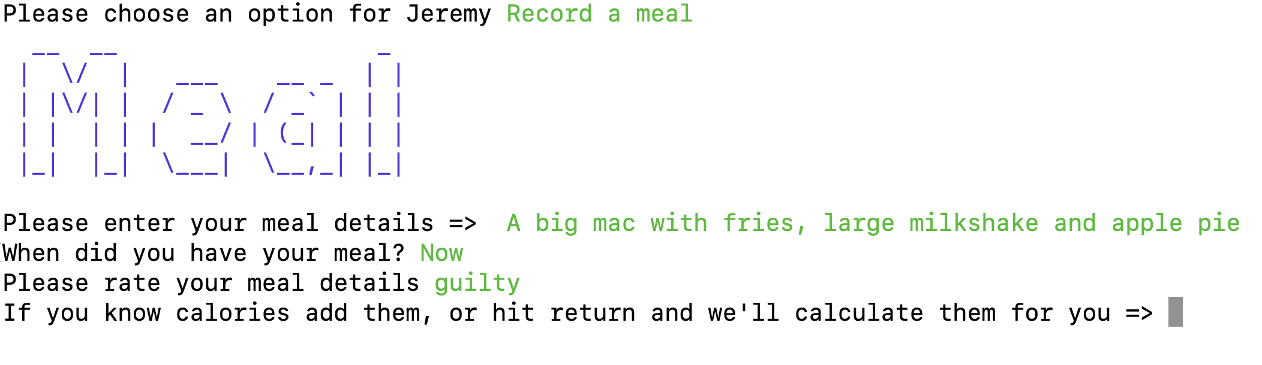

Slide 13
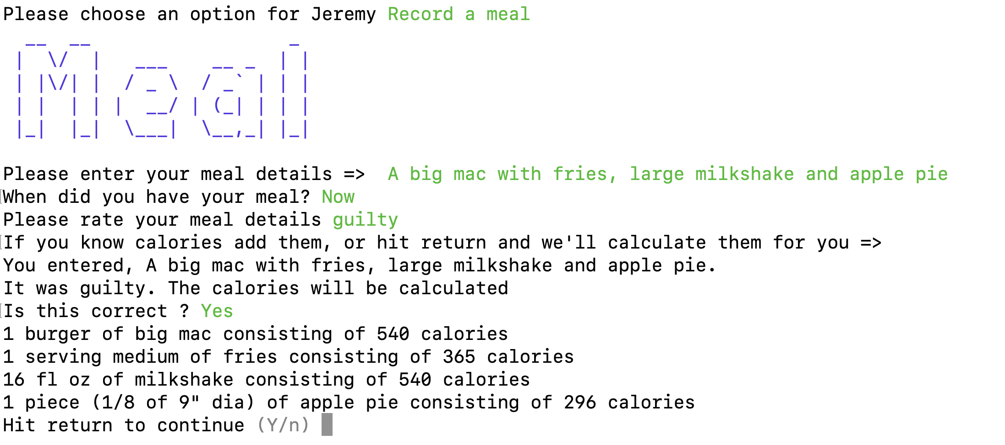

Slide 14
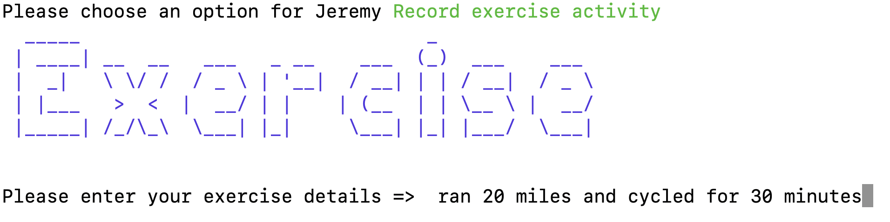

Slide 15
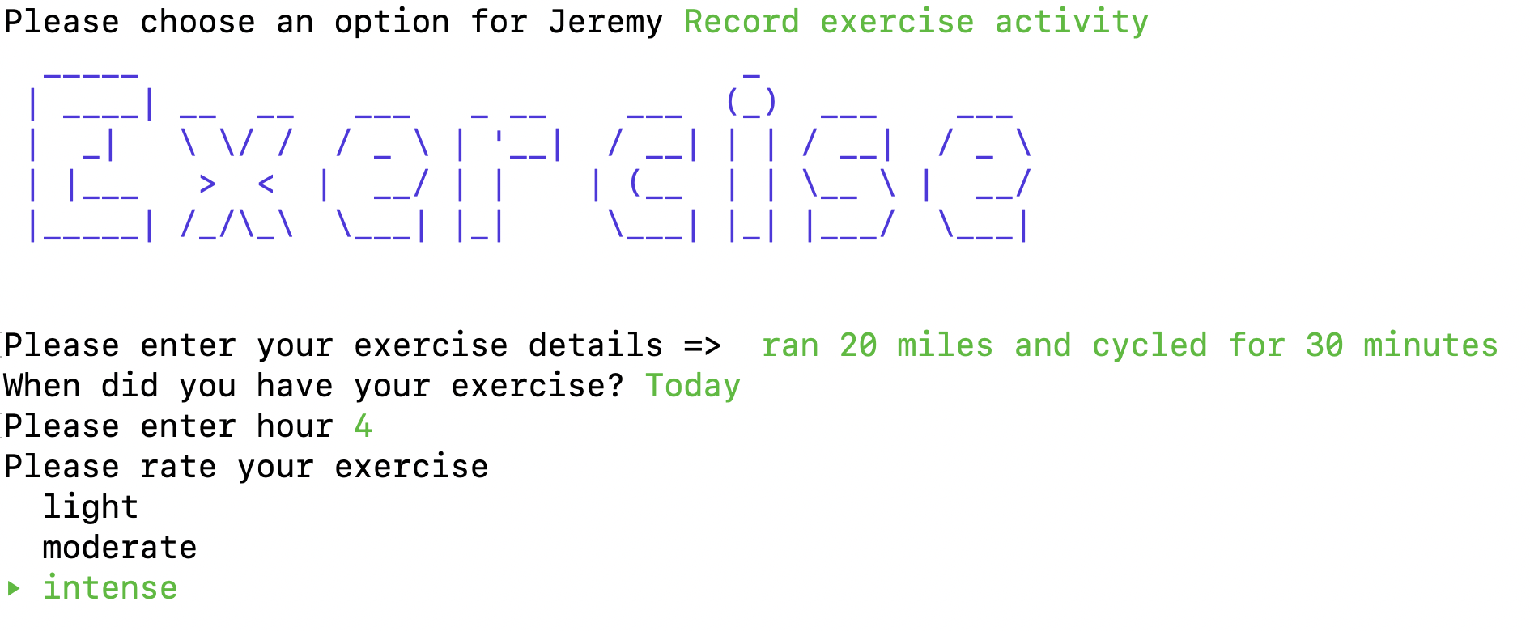

Slide 16
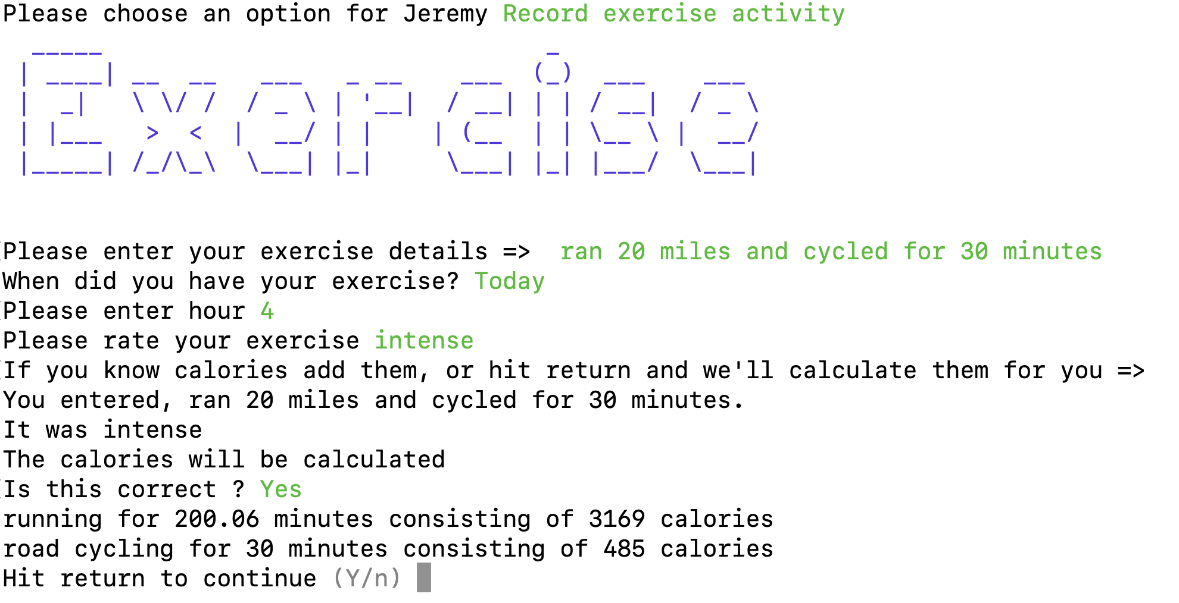

Slide 17
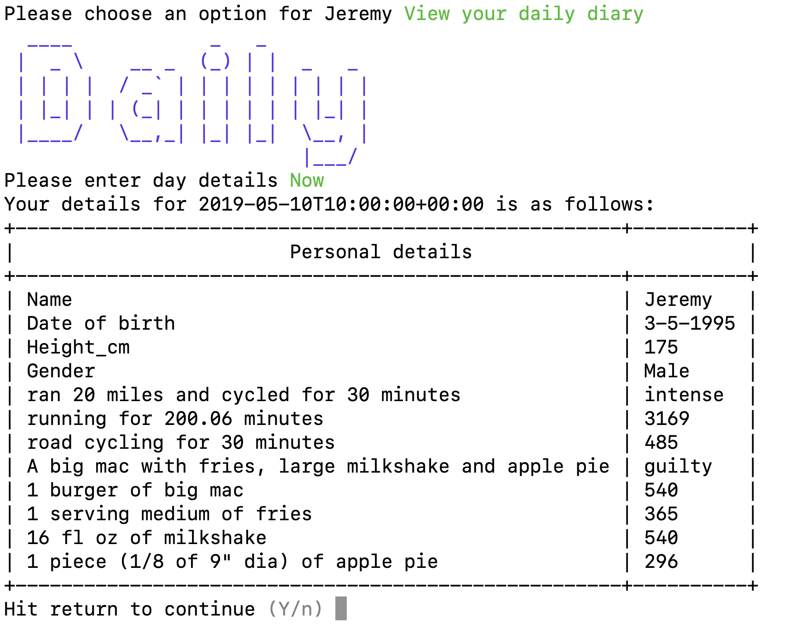

Slide 18
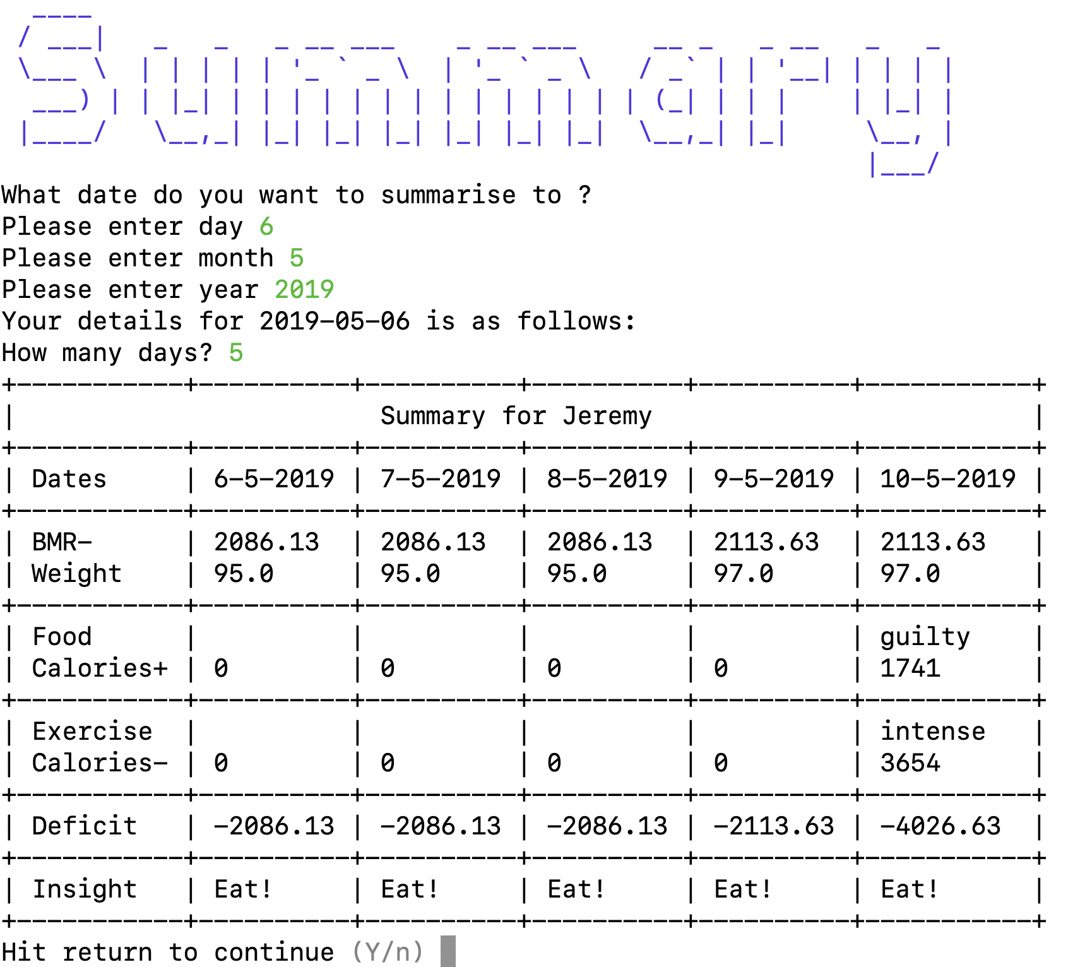

Slide 19
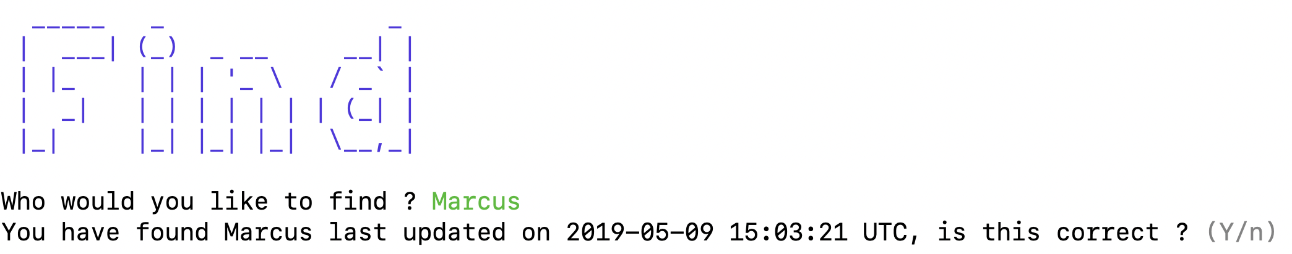

Slide 20
